Slide 1
Regex and scraping
2022-2023

Slide 2
What you should already know?
Basics of Python
Conditionals – Loops
Functions
Collections: List – Tuple – Dictionary – Set
File I/O: txt, csv, XML
First steps in Data Science with Python
Intro in using the NumPy & MatPlotLib libraries

Slide 3
Scaling up your Python programming skills
OO programming
Built-in functions for working with collections
Lambda functions
List Comprehensions

Slide 4

Regex
Regular expressions:
Regexes can be used in any language, but we’ll be using Python
In themselves they’re a rather theoretical exercise, but when doing webscraping you’ll see the point.
Or when we’re datacleaning…
A regular expression (shortened as regex or regexp;^{[1]} also referred to as rational expression^{[2][3]}) is a sequence of characters that specifies a search pattern in text. Usually such patterns are used by string-searching algorithms for "find" or "find and replace" operations on strings, or for input validation.

Slide 5
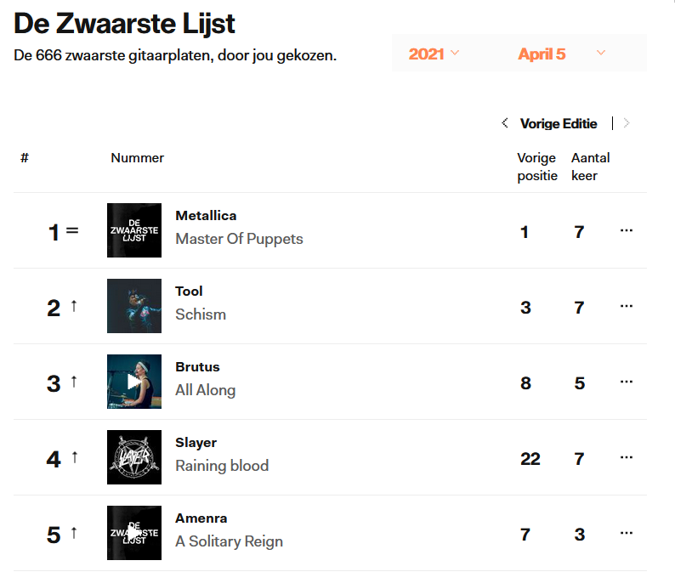
Regex
A regex is an expression which matches (or not matches) another string. This means you can check if a string is a properly formed date, or a gender, or …
You can also use regexes to find extract parts of strings. Like taking al the bands from “De Zwaarste Lijst” on the stubru-website…
Note: they’re all bold
This means between “<b>”-tags in HTML
Notes:
https://stubru.be/stem/dezwaarstelijst/lijst

Slide 6
Basic regexes
Regex | Matches
a | The character “a”
abc | The string “abc”
[abc] | “a”, “b” or “c”
[^abc] | Everything but “a”, “b” or “c”
abc|def | “abc” or “def”
\d | Any digit
\D | Any non-digit
\s | Any whitespace (space, but also newline)
\S | Everything but \s
\w | Matches any alphanumeric char (incl. “_”)
\W | Everything but \W
. | Any character, but only once
[a-z] | Any lowercase character
[A-Z] | Any uppercase character
[0-9] | Any digit, equal to \d
So what matches what?
Modify the expressions with quantifiers.
Quantifier | Multiplies how?
* | Zero or more times
+ | One or more times
? | Zero or once
{3} | Exactly three times
{3,6} | Three to six times
{3,} | Three or more times
{,6} | Up to 6 times
$ | End of the string
^ | Beginning of string
Notes:
This slide is way overloaded, but it contains all you really need to know.

Slide 7
Regex groups
A regex group is anything between brackets ( “(“ and “)” )
You can refer to these groups using \1, \2, \3, …
\1 is the first group, \2 the second, etcetera…
When applying regexes to strings, the groups are returned individually
When you don’t specify groups, the entire found text is returned
Example: word that begins and ends with the same letter: “(.).*\1”

Slide 8
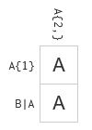
Regex
The previous two slides were all you needed to know
Now you can apply Regexes in any language
PowerShell, Perl, Java, C#, …
Let’s first try that out:
https://regexcrossword.com/
Example:
A{2,} : At least two A’s -> AA
A{1} : Exactly one A -> A
B|A : B or A -> A
You should be able to finish the beginners, intermediate and expert puzzles
When in doubt, use https://regex101.com/ to explain why something is wrong

Slide 9
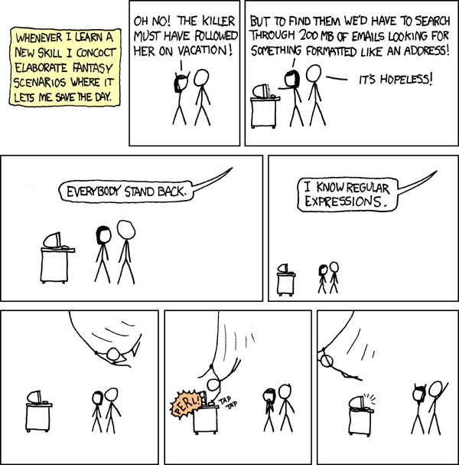
Notes:
https://xkcd.com/208/

Slide 10
Regex in Python
All good and well, but how do we use this in Python?
First import “re” (usually not given an alias)
Then use one of the following functions:
re.search(regex, s): returns the first match of the regular expression, even if this match is in the middle of the string
re.match(regex, s): returns the first match of the regular expression, but only if this match is in the beginning of the string
re.finditer(regex, s): returns an iterator consisting of all matches of regex
re.findall(regex, s): returns a list of all matches of the regex
re.sub(regex, new_text, s): substitutes all matches of the regex in the input string s with new_text and returns this

Slide 11
Example:
import re s = "I went to the zoo and saw _lions_, _tigers_ and _meerkats_."
We start out with the text on top of this slide.
Note: “found” is not a string, but an object
https://docs.python.org/3.10/library/re.html#match-objects
When using this object remember you’re using groups in regexes
Hence the constant usage of ‘group’
When only looking for one match, group will always be zero (the first group, also the default option)
found = re.search(r"lion", s)
print(found)
Notes:
R-strings: Raw strings, used for regex because they don’t interpret the \ as a special character

Slide 12


Example: Match-object
found = re.search(r"lion", s)
print(found.group(), found.start(), found.end())
But did we visit the flamingos?
If nothing is found, return value is of “None” type which evaluates to False in an if
found = re.search(r"flamingo", s)
print(found)
print("We found it!") if found else print("Nothing here...")
found = re.match(r"tiger", s)
print(found)
found = re.match(r"I\s", s)
print(found)
Notes:
Also: lookup “Python shorthand if”

Slide 13
Example: greedy *
Find the first animal (between underscores):
No:
* is greedy: it will take as much as it can
2 solutions: match only characters, or match anything but underscore
found = re.search(r"_.*_", s)
print(found.group())
found = re.search(r"_[a-zA-Z]*_", s)
print(found.group())
found = re.search(r"_[^_]*_", s)
print(found.group())

Slide 14

Example: iterators and iterables
We want to know all animals
finditer: returns an iterator, not an iterable
findall: returns a list, which is an iterable
https://www.geeksforgeeks.org/python-difference-iterable-iterator/
Any iterable can be used to generate an iterator. This is what is done implicitly when used in a loop.
Iterables: string, list, tuple, …
You’re used to iterables, so use findall instead
found = re.finditer(r"_[a-zA-Z]*_", s)
for f in found:
print(f.group())

Slide 15


Example: find more
found = re.findall(r"_[a-zA-Z]*_", s)
[print(f) for f in found]
Since we’re using findall, we don’t get Match-objects anymore but a simple list of matches.
But the underscores are annoying. We need them to search for the animals, but we know they’re there and don’t need them in the result.
The solution: parenthesis. But the part of the regex you’re interested in between them.
found = re.findall(r"_([a-zA-Z]*)_", s)
[print(f) for f in found]

Slide 16
Example: replace
Let’s get rid of all the underscores.
Or let’s get replace every T that is followed by another letter with an X.
What happened? The entire regex was replaced, not just the T. To fix that we have to use groups…
new_s = re.sub(r"_", r"", s)
print(new_s)
new_s = re.sub(r"t[a-zA-Z]+", r"X", s)
print(new_s)

Slide 17

Example: replace using groups
new_s = re.sub(r"t([a-zA-Z]+)", r"X\1", s)
print(new_s)
“\1” is the first group that was found
You can also use \2, \3, …
A group is anything between brackets
Can also be used in the expression itself, like checking if the first character is the same as te last:
found = re.match(r"(.{1}).*\1$", "hannah")
print(found)
found = re.match(r"(.{1}).*\1$", "kasper")
print(found)
Notes:
Trick question:
found = re.search(r"(.{1}).*\1$", "marieke")
print(found)
True or false? And why is that not a problem with the examples in the slide?

Slide 18

List of computers
Regex example in Jupyter Notebook

Slide 19
Webscraping in Python

Slide 20
Webscraping
Webscraping is the process of scraping information off websites
You’ll transform data is meant to look nice and readable into a form that a programming language can work with easily
Mostly this is pretty silly, as you’re creating a database from a website that was created from a database
But the creator of the database doesn’t allow you into their database, so you have to reverse-engineer it
It’s a bit of a cat chasing her tail: a scrape only works as long as the website isn’t changed
But in a good and programmatically challenging way

Slide 21
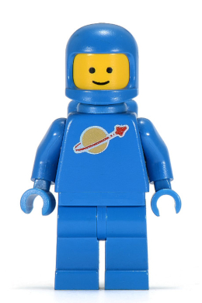
List of minifigs
Webscraping example in Jupyter Notebook

Slide 22

De zwaarste lijst
A list of heavy metal records by StuBru, the Flemish radio station

